Slide 1
Standards and Objectives
Slides for Lessons

Slide 2
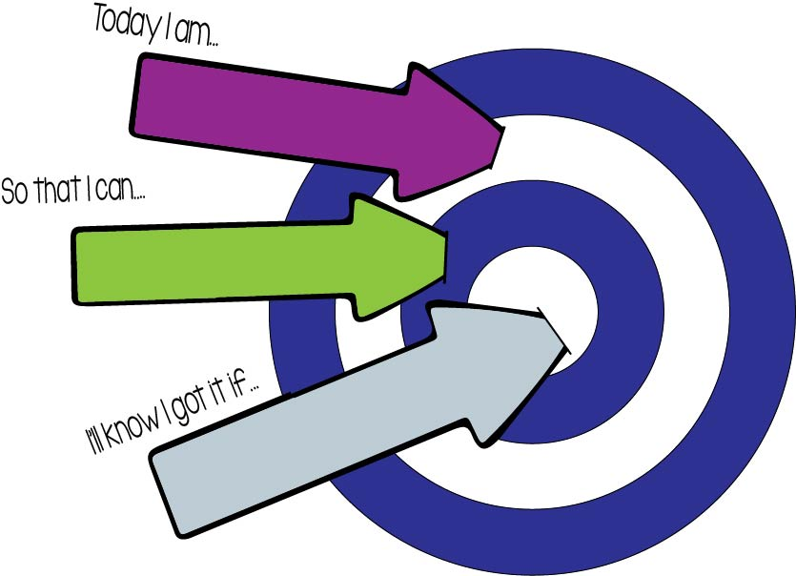
Learning Target
working with
objective
I can…
Standard:

Slide 3
Step up to Learn!
Standard:
Mastery level objective including rigor from standard
Intermediate level work toward objective
Basic skill needed as foundation toward objective

Slide 4
Today
Agenda:
Objective:
Standard:

