Slide 1
Rubric Resources
Looking for ways to enhance your instruction? Check out these resources, aligned to the Students First Coaching Rubric, to help inform your instructional practices.

Slide 2
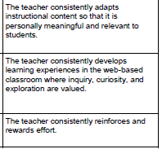
Engaging students
Resources:
Learn more:
http://www.edutopia.org/blog/golden-rules-for-engaging-students-nicolas-pino-james
http://www.edutopia.org/project-based-learning-student-motivation
Adapting Instructional Content
http://www.readingrockets.org/article/how-adapt-your-teaching-strategies-student-needs
Motivating Students:
http://teach4theheart.com/2014/09/22/10-ways-to-motivate-your-students-to-learn/
Instructional Strategies:
http://www.fortheteachers.org/instructional-strategy-ideas-2/
http://teachhighschoolmath.blogspot.com/2013/02/how-can-you-measure-student-engagement.html
What this looks like:

Slide 3
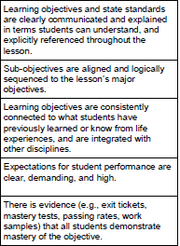
Standards and objectives
Resources:
Learn more:
http://www.edutopia.org/blog/meaningful-connections-objectives-and-standards-karen-lea
http://dataworks-ed.com/how-to-craft-a-learning-objective-from-a-common-core-state-standard/
Sharing Objectives:
http://all4theloveofteaching.blogspot.com/2013/08/goals-in-sight.html#.V73l1fZVikp
Evidence of Mastery:
http://www.edutopia.org/blog/dipsticks-to-check-for-understanding-todd-finley?crlt_pid=camp.LQD8qeICCkYd
http://4thgraderacers.blogspot.com/2015/06/3-ways-to-check-for-understanding-with.html
What this looks like:

Slide 4
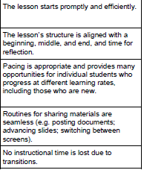
Lesson structure and pacing
Resources:
Learn more:
http://www.edutopia.org/blog/instructional-pacing-tips-rebecca-alber
http://iseesam.com/content/teachall/text/behavior/LRBIpdfs/Instructional.pdf
http://curriculumandinstructionpresentation.wikispaces.com/file/view/Untitled.jpg/191554172/Untitled.jpg
Lesson Pacing:
http://www.davis.k12.ut.us/cms/lib09/UT01001306/Centricity/Domain/26/Micro%20PD/Pacing/Pacing-Leader%20Notes-final.pdf
Routines and Transitions:
http://teachingld.net/pdf/teaching_how-tos/mcIntosh37-1.pdf
What this looks like:

Slide 5
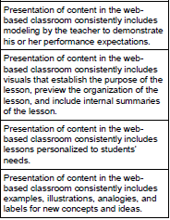
Presenting instructional content
What this looks like:
Resources:
Learn more:
http://elearninginfographics.com/the-roberto-marzanos-9-effective-instructional-strategies-infographic/?crlt.pid=camp.V3YbHVJ1NloF
Modeling and Visuals:
http://info.shiftelearning.com/blog/10-types-of-visual-content-elearning
http://fcit.usf.edu/mathvids/strategies/em.html
Personalized Learning:
http://www.educatorstechnology.com/2015/01/personalized-learning-vs-traditional.html

Slide 6
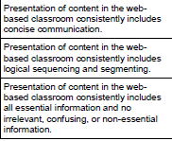
Presenting instructional content, continued
What this looks like:
Resources:
Concise Communication:
http://ideaedu.org/research-and-papers/pod-idea-notes-on-instruction/idea-item-no-10/
Sequencing:
http://www.educ.ualberta.ca/staff/olenka.bilash/best%20of%20bilash/lesson%20sequencing.html
Essential Information:
http://www.educationworld.com/a_admin/greatmeetings/greatmeetings033.shtml

Slide 7
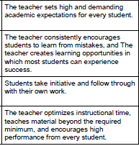
expectations
Resources:
Learn More:
http://teachlikeachampion.com/wp-content/uploads/Lemov-Chapter-1.pdf
Setting Expectations:
http://teachingasleadership.org/sites/default/files/Related-Readings/DCA_Ch2_2011.pdf
Learning From Mistakes:
https://chrishildrew.wordpress.com/2014/08/10/growth-mindset-launch/
Student Initiative:
http://www.rootsofaction.com/initiative-children-adolescents/
Encouraging High Performance:
http://www.kidsource.com/kidsource/content3/work.expectations.k12.4.html
What this looks like:

Slide 8
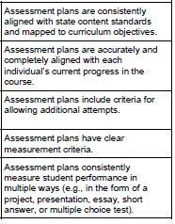
assessment
Resources:
Learn More:
http://drexel.edu/dcae/assessment/assessment-plans/
http://people.virginia.edu/~cat3y/presentations/ASCD09/RexOrlandoBreakouts/AssessFL.pdf
Standards and Objectives:
http://www.cmu.edu/teaching/assessment/howto/basics/objectives.html
Clear Measurement Criteria:
http://www.ascd.org/publications/books/109031/chapters/Leveling-the-Playing-Field@-Sharing-Learning-Targets-and-Criteria-for-Success.aspx
Multiple Measures:
http://www.ascd.org/publications/educational-leadership/nov09/vol67/num03/The-Many-Meanings-of-%C2%A3Multiple-Measures%C2%A3.aspx
What this looks like:

Slide 9
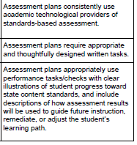
Assessment, continued
What this looks like:
Resources:
Assessment Technology:
http://www.edutopia.org/blog/5-fast-formative-assessment-tools-vicki-davis
Written Tasks:
http://wac.colostate.edu/books/gardner/chapter3.pdf
http://www.nwp.org/cs/public/download/nwp_file/15440/Wise_Eyes.pdf?x-r=pcfile_d
Using Data:
http://www.edutopia.org/blog/using-student-data-inform-teaching-rebecca-alber
https://www.engageny.org/resource/data-driven-instruction-action-planning-templates

Slide 10
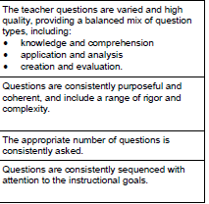
questioning
Resources:
Learn More:
https://us.corwin.com/sites/default/files/upm-binaries/41845_Ch_1_Stoehr.pdf
http://beyondpenguins.ehe.osu.edu/issue/energy-and-the-polar-environment/questioning-techniques-research-based-strategies-for-teachers
https://www.lanecc.edu/sites/default/files/fpd/questioning.pdf
http://personalmasteryandtechnology.weebly.com/31-increasing-engagement-by-incorporating-student-voice.html
Question Types:
http://www.lamission.edu/devcom/ProbingQuestions.htm
Question Rigor and Complexity:
http://www.ocmboces.org/tfiles/folder2790/Rigorous%20Questioning%204.30.13_1409.pdf
http://www.iss.k12.nc.us/cms/lib4/NC01000579/Centricity/Domain/4083/How_to_Ensure_Rigorous_Question_for_Higher_level_Thinking.pdf
What this looks like:

Slide 11
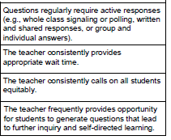
Questioning, continued
Resources:
Wait Time:
http://www.ericdigests.org/1995-1/think.htm
Calling on Students Equitably:
http://www.edutopia.org/blog/practices-promote-equity-in-classroom-shane-safir
http://educaitionaltechnology.bajgier.net/2013/09/calling-on-students-equitably-to-boost-engagement/
Inquiry-Based Learning:
http://www.teach-nology.com/currenttrends/inquiry/
http://www.edutopia.org/blog/strategies-for-inquiry-based-learning-john-mccarthy
http://www.thirteen.org/edonline/concept2class/inquiry/
What this looks like:

Slide 12
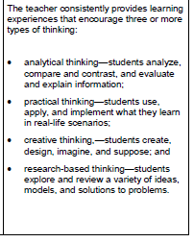
thinking
What this looks like:
Resources:
Learn More:
http://www.ascd.org/publications/educational_leadership/feb08/vol65/num05/The_Thought-Filled_Curriculum.aspx
http://www.p21.org/news-events/p21blog/1435-strategies-to-promote-critical-thinking-in-the-elementary-classroom
Types of Thinking:
http://thepeakperformancecenter.com/educational-learning/thinking/
https://prezi.com/a8vokzur92h2/thinking-presentation/
http://webshare.greenwich.k12.ct.us/teplhandbook/Thinking_Examples.html

Slide 13
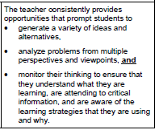
Thinking, continued
Resources:
Generating Ideas:
http://www.teachhub.com/teaching-strategies-promote-critical-thinking
https://k12teacherstaffdevelopment.com/tlb/how-can-i-facilitate-brainstorming-in-the-classroom/
http://www.allkindsofminds.org/generating-and-organizing-ideas-having-lots-of-ideas-impact-of-higher-order-cognition-creativity-and-brainstorming
Metacognition:
http://www.edutopia.org/blog/metacognition-gift-that-keeps-giving-donna-wilson-marcus-conyers
http://learningspecialistmaterials.blogspot.com/2014/05/teaching-students-metacognitive.html
What this looks like:

Slide 14
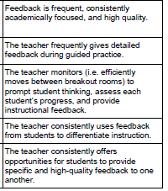
Academic feedback
Resources:
Learn More:
http://www.edutopia.org/blog/tips-providing-students-meaningful-feedback-marianne-stenger
http://old.sper.usu.edu/assets/PeerTutoring/Readings/Acad%20Feedback(Chapter%204).pdf
Providing Detailed Feedback:
http://dailygenius.com/optimizing-student-feedback/
http://www.ascd.org/publications/books/108019/chapters/Types-of-Feedback-and-Their-Purposes.aspx
http://www.ascd.org/publications/educational-leadership/sept12/vol70/num01/Seven-Keys-to-Effective-Feedback.aspx
Receiving Student Feedback:
http://www.cultofpedagogy.com/student-feedback/
http://www.edutopia.org/blog/student-feedback-improves-your-teaching-vicki-davis
Peer Feedback:
http://blogs.edweek.org/teachers/work_in_progress/2014/10/empowering_students_feedback.html
http://www.assessmentforlearning.edu.au/professional_learning/peer_feedback/peer_strategies_enhance.html
What this looks like:

Slide 15
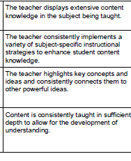
Teacher content knowledge
Resources:
Learn More:
http://tinyurl.com/hctor2s
Subject-Specific Strategies:
Math: https://nceo.umn.edu/docs/Presentations/NCTMLEPIEPStrategiesMathGlossaryHandout.pdf
ELA K-5: http://www.isbe.net/common_core/pdf/ela-teach-strat-read-text-k-5.pdf
ELA 6-12: http://www.isbe.net/common_core/pdf/ela-teach-strat-read-text-6-12.pdf
Science: http://serc.carleton.edu/k12/teaching_strategies.html
Social Studies: http://www1.udel.edu/dssep/strategies.htm
Making Powerful Connections to Key Concepts and Ideas:
http://www.ascd.org/publications/books/102112/chapters/Making_a_Real-World_Connection.aspx
http://www.teachhub.com/top-12-ways-bring-real-world-your-classroom
Content Depth:
http://www.edutopia.org/blog/webbs-depth-knowledge-increase-rigor-gerald-aungst
What this looks like:

Slide 16
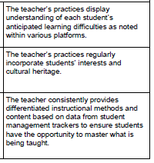
Teacher knowledge of students
Resources:
Learn More:
http://www.educationworld.com/a_curr/columnists/mcdonald/mcdonald013.shtml
http://www.ascd.org/publications/books/111011/chapters/Knowing-Our-Students-as-Learners.aspx
Learning Difficulties and Differentiation:
http://www.umassd.edu/dss/resources/facultystaff/howtoteachandaccommodate/howtoaccommodatedifferentlearningstyles/
http://education.cu-portland.edu/blog/teaching-strategies/examples-of-differentiated-instruction/
Student Interests:
http://www.edutopia.org/blog/differentiated-instruction-learner-interest-matters-john-mccarthy
Cultural Responsiveness:
http://www.indiana.edu/~equity/docs/Strategies_for_WOrking_with_Culturally_Diverse_Students__Renae_Azziz.pdf
What this looks like:

Slide 17
Student centered learning
Resources:
Learn More:
http://www.edutopia.org/blog/student-centered-learning-starts-with-teacher-john-mccarthy
http://www.facultyfocus.com/articles/effective-teaching-strategies/five-characteristics-of-learner-centered-teaching/
Strategies:
https://www.facinghistory.org/resource-library/teaching-strategies
https://my.baker.edu/icsfileserver/docs/departments/academics/etl/Activities%20for%20Learner-Centered%20Teaching.doc

Slide 18
Want more ideas?
Check out the coaching website and Pinterest page for additional resources:
Website: http://coachingspot.weebly.com/
Pinterest: https://www.pinterest.com/KriegerK12

